Slide 1
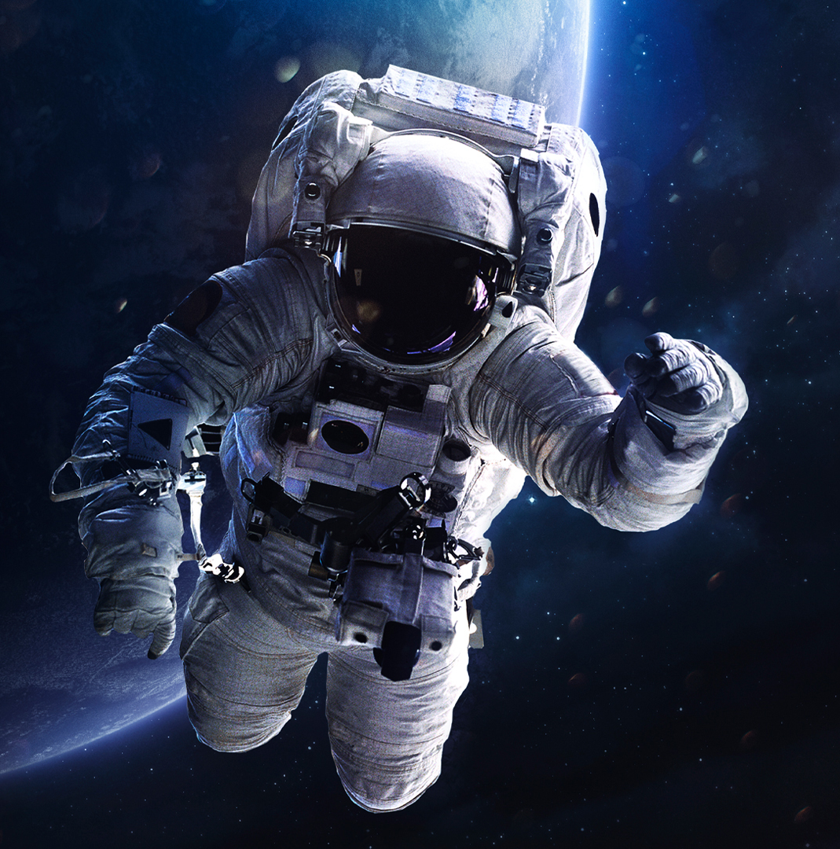
When the wise man points to the ISS
Direction and calculation team
Alex Zakaluzhskii & Mathilde Rossier
Notes:
Hello everyone. Alex and myself worked on the Direction and Calculation part. We divided the work in two parts. Alex worked on the iss trajectory and I worked on the eart vectors, coordinate systems and angles equations. To begin with our presentation, I’ll let Alex explain his part.

Slide 2
Alex’s part

Slide 3
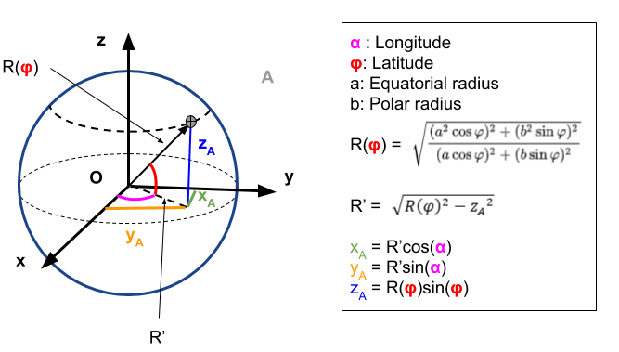
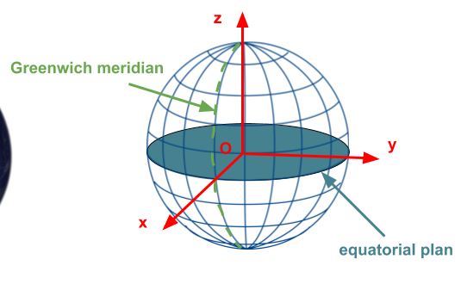
Earth vectors
Notes:
The first step of my part was to find the position vectors of the ISS tracker on earth. To do so we worked with a coordinates system that turns with the earth so that we have the sensation that the earth don’t rotate and the coordinates of the tracker never change. To find these coordinates, we need the latitude, longitude and radius of the place on earth where iss tracker is. One important thing for this part is that the earth is not a perfect sphere but an ellispoid. For that, the radius is not the same everywhere and has to be calculate for each place. After finding the radius, it’s simple trigonometry to find the vector.

Slide 4
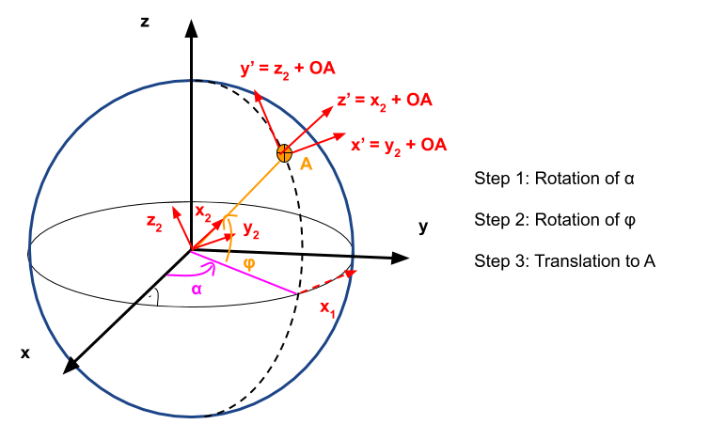
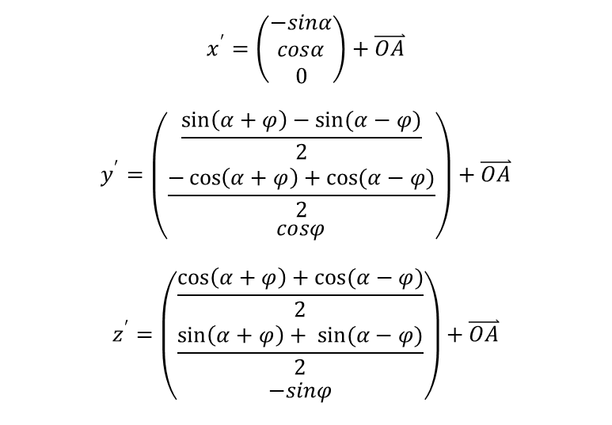
Local coordinates system
$$x^{′}=\left(\begin{matrix}−sinα \\ cosα \\ 0\end{matrix}\right)+\overset{⃑}{OA}$$
$$y^{′}=\left(\begin{matrix}\frac{\sin\left(α+φ\right)−sin(α−φ)}{2} \\ \frac{−\cos\left(α+φ\right)+cos(α−φ)}{2} \\ cosφ\end{matrix}\right)+\overset{⃑}{OA}$$
$$z^{′}=\left(\begin{matrix}\frac{\cos\left(α+φ\right)+cos(α−φ)}{2} \\ \frac{\sin\left(α+φ\right)+ sin(α−φ)}{2} \\ −sinφ\end{matrix}\right)+\overset{⃑}{OA}$$
Notes:
The second step is to define a new local coordinates system at the point on earth where the tracker is. These new basis vectors are defined through two rotations and one translation. We need this basis so that we can calculate the angles between the tangential plane and the iss and the normal plane and the iss vector (that is given by alex program). In the end the iss vector is also transformed in the new coordinates system.

Slide 5
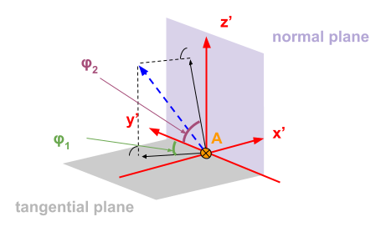
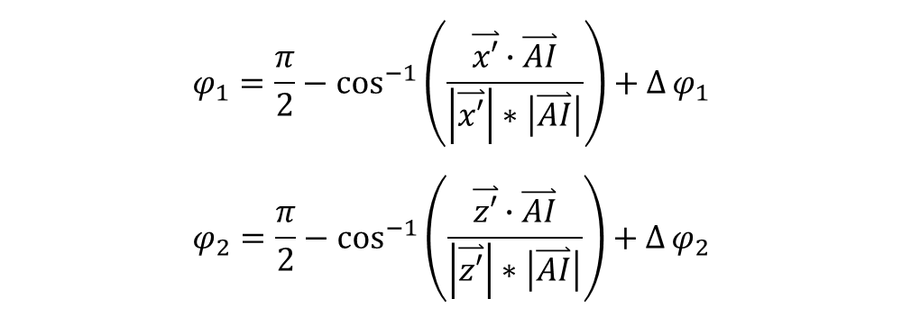
Angles calculation
$$φ_{1}=\frac{π}{2}−\cos^{−1}\left(\frac{\overset{⃑}{x′}∙\overset{⃑}{AI}}{\left|\overset{⃑}{x′}\right|∗\left|\overset{⃑}{AI}\right|}\right)+∆φ_{1}$$
$$φ_{2}=\frac{π}{2}−\cos^{−1}\left(\frac{\overset{⃑}{z′}∙\overset{⃑}{AI}}{\left|\overset{⃑}{z′}\right|∗\left|\overset{⃑}{AI}\right|}\right)+∆φ_{2}$$
Notes:
Once we have the new basis and the iss vector expressed in it, the angles are obtained through a simple formula (scalar product). The last thing to controll are the initial angles of the machine and the position of the north so that we are sure to give the correct angles to the trackers motors. These variations in angles are the deltas in the formulas.

Slide 6
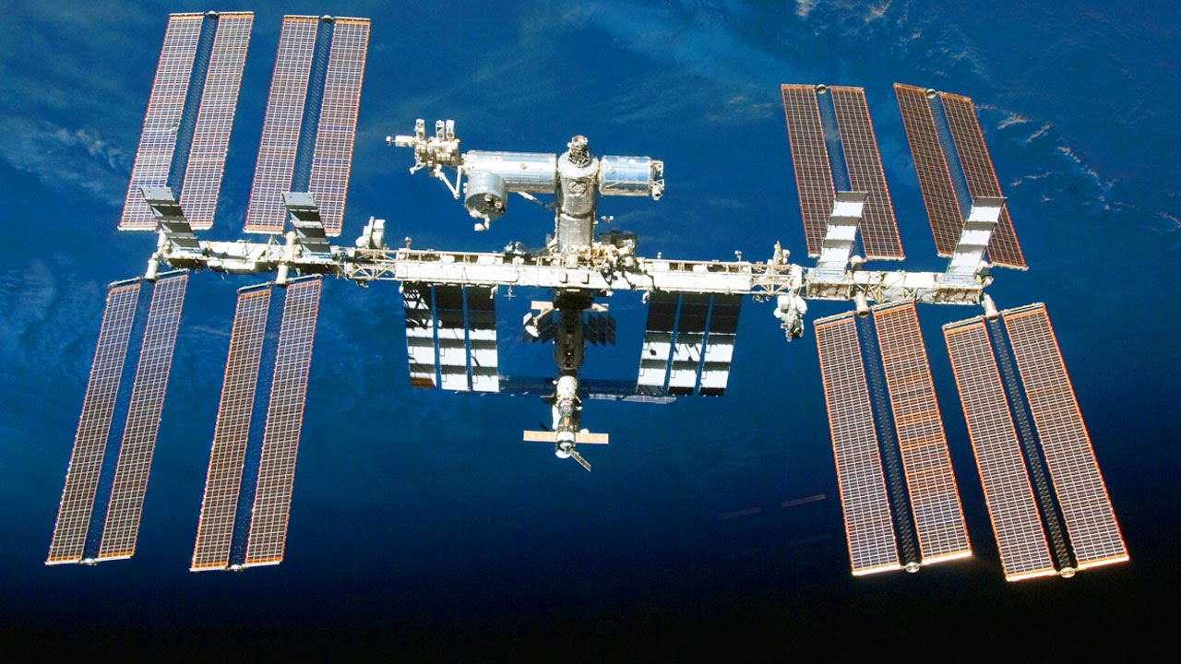
Thank you for your attention

Slide 7
Sources
Pic1:
Last pic:
Cette photo par Auteur inconnu est soumise à la licence CC BY-ND
Cette photo par Auteur inconnu est soumise à la licence CC BY

